Slide 1
CS1231
Tutorial 4

Slide 2
Things to do
Things to note
About the quiz
Sheet 4
Further problems
Questions

Slide 3
Things to note
We will go through sheet 4 today.
As usual, I encourage participation at appropriate times.
Participation includes unmuting, introducing yourself and using the annotate button on zoom.
If you do not wish to participate or , click the cross reaction. If I do not see a cross then I will assume that I can call upon you.
If you want to be want to ensure that you’re called upon then click on the tick reaction.
If you have a question raise your hand. Please save longer and more involved questions for the end of the class. Alternatively you can email me.

Slide 4
Thing to note
You are free to change your reaction as the lesson progresses.
We will not go through * questions. They will be saved for Professor Tay’s tutorial.

Slide 5
About the quiz
After moderation, the average result for the quiz is around 65%.
I will be arranging a meeting with a few of you to better understand your learning needs.
This meeting will either be in-person or via zoom.
You will be contacted through email. Please check it regularly.
If you don’t get an email from me, but wish to see me then feel free to email me.

Slide 6

Review of lectures
Let A and B be sets. What is the cartesian product A$×$B?
In general, does A$×$B = B$×$A?

Slide 7

Review of lectures
A$×$B=$\{\left(x,y\right):x∈A,y∈B\}$.
In general $A×B≠B×A$. For a counter-example, take $A=\left\{0\right\}$ and $B=\{1\}$. In this case, $A×B=\left\{\left(0,1\right)\right\}$ and $B×A=\{(1,0)\}$.

Slide 8

Review of lectures
Let $A_{1}…A_{n}$ be sets. What is the cartesian product $A_{1}×…×A_{n}$?
Describe the sets $ℝ^{2}$ and $ℝ^{3}$.

Slide 9

Review of lectures
$A_{1}×…×A_{n}=\{\left(a_{1},…,a_{n}\right):a_{i}∈A_{i}\}$.
$ℝ^{2}$ and $ℝ^{3}$ describe two-dimensional and three-dimensional space respectively.

Slide 10
Sheet 4: Question 1
A basic exercise to get you to compute cartesian products.

Slide 11
Sheet 4: Question 1
Let A = {0, 1}, B = {a, b, c} and C = {01, 10}. Determine the following:
B × C = {(a, 01),(b, 01),(c, 01),(a, 10),(b, 10),(c, 10)}.
(b) A × B × C = {(0, a, 01),(0, b, 01),(0, c, 01),(0, a, 10),(0, b, 10),(0, c, 10), (1, a, 01),(1, b, 01),(1, c, 01),(1, a, 10),(1, b, 10),(1, c, 10)}.
(c) ∅ × A = {(b, c) : b ∈ ∅ ∧ c ∈ A} = ∅.

Slide 12
Sheet 4: Question 1
(d) P({∅}) × A = {∅, {∅}} × {0, 1} = {(∅, 0),(∅, 1),({∅}, 0),({∅}, 1)}.

Slide 13
Sheet 4: Questions 3,4,5,6,7,8
Questions to help you familiarise yourself with relations.
Inverse and composition of relations.
Set and diagrammatic representations of relations.

Slide 14
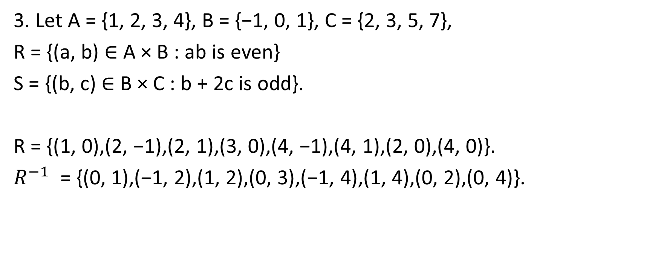
Question 4: Sheet 3
3. Let A = {1, 2, 3, 4}, B = {−1, 0, 1}, C = {2, 3, 5, 7},
R = {(a, b) ∈ A × B : ab is even}
S = {(b, c) ∈ B × C : b + 2c is odd}.
R = {(1, 0),(2, −1),(2, 1),(3, 0),(4, −1),(4, 1),(2, 0),(4, 0)}.
$R^{−1}$ = {(0, 1),(−1, 2),(1, 2),(0, 3),(−1, 4),(1, 4),(0, 2),(0, 4)}.

Slide 15

Sheet 4: Question 3
R = {(1, 0),(2, −1),(2, 1),(3, 0),(4, −1),(4, 1),(2, 0),(4, 0)}.
$R^{−1}$ = {(0, 1),(−1, 2),(1, 2),(0, 3),(−1, 4),(1, 4),(0, 2),(0, 4)}.

Slide 16

Sheet 4: Question 3
S = {(−1, 2),(−1, 3),(−1, 5),(−1, 7),(1, 2),(1, 3),(1, 5),(1, 7)}.
$S^{−1}$ = {(2, −1),(3, −1),(5, −1),(7, −1),(2, 1),(3, 1),(5, 1),(7, 1)}.

Slide 17
Sheet 4: Question 3
R = {(1, 0),(2, −1),(2, 1),(3, 0),(4, −1),(4, 1),(2, 0),(4, 0)}.
S = {(−1, 2),(−1, 3),(−1, 5),(−1, 7),(1, 2),(1, 3),(1, 5),(1, 7)}.
S ◦ R = {(2, 2),(2, 3),(2, 5),(2, 7),(4, 2),(4, 3),(4, 5),(4, 7)}.

Slide 18
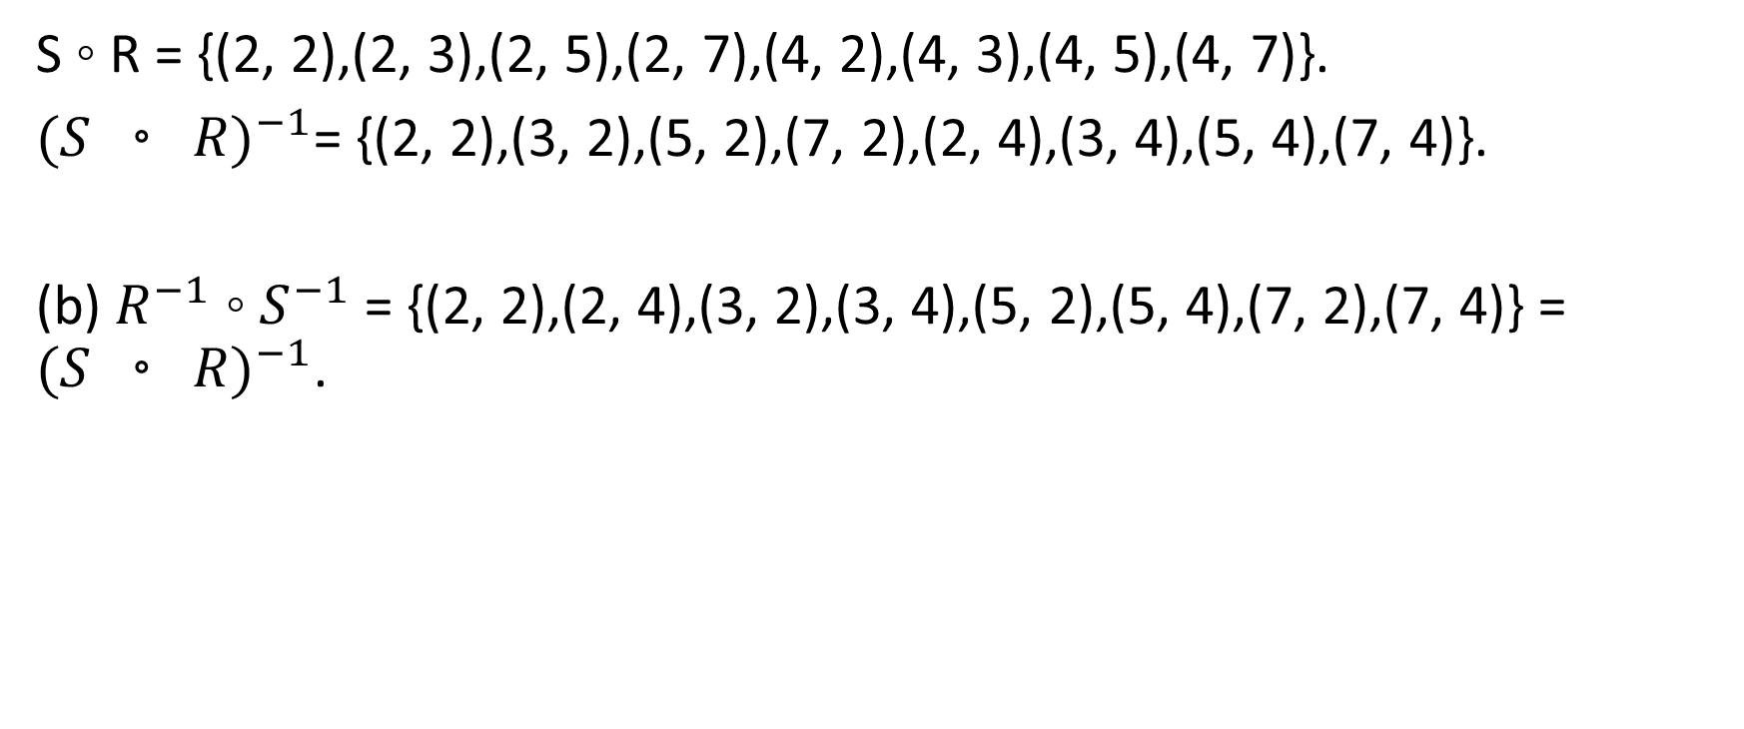
Sheet 4: Question 3
S ◦ R = {(2, 2),(2, 3),(2, 5),(2, 7),(4, 2),(4, 3),(4, 5),(4, 7)}.
${(S ◦ R)}^{−1}$= {(2, 2),(3, 2),(5, 2),(7, 2),(2, 4),(3, 4),(5, 4),(7, 4)}.
(b) $R^{−1}$ ◦ $S^{−1}$ = {(2, 2),(2, 4),(3, 2),(3, 4),(5, 2),(5, 4),(7, 2),(7, 4)} = ${(S ◦ R)}^{−1}$.

Slide 19
Sheet 4: Question 4
Left to attempt.

Slide 20
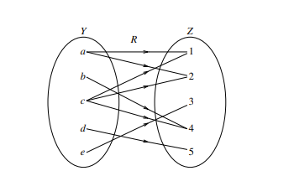
Sheet 4: Question 5
5. Let Y = {a, b, c, d, e} and Z = {1, 2, 3, 4, 5}, and the arrow diagram of the relation R from Y to Z be as shown on the right.
(a) Determine $R^{−1}$.
$R=\{\left(a,1\right),\left(a,2\right),\left(b,4\right),\left(c,1\right),\left(c,2\right),\left(c,4\right),\left(d,5\right),(e,3)\}$.
$$R^{−1}=\left\{\left(1,a\right),\left(1,c\right),\left(2,a\right),\left(2,c\right),\left(3,e\right),\left(4,b\right),\left(4,c\right),\left(5,d\right)\right\}.$$

Slide 21

Sheet 4: Question 5
(b) Determine $R^{−1}∘R$.
$$R^{−1}=\left\{\left(1,a\right),\left(1,c\right),\left(2,a\right),\left(2,c\right),\left(3,e\right),\left(4,b\right),\left(4,c\right),\left(5,d\right)\right\}.$$
$R^{−1}∘R=\{\left(a,a\right),\left(a,c\right),\left(b,b\right),\left(b,c\right), \left(c,a\right),\left(c,b\right),\left(c,c\right),\left(d,d\right),(e,e)\}$.
$R=\{\left(a,1\right),\left(a,2\right),\left(b,4\right),\left(c,1\right),\left(c,2\right),\left(c,4\right),\left(d,5\right),(e,3)\}$.

Slide 22

Sheet 4: Question 6
S = {(m, n) ∈ $ℤ^{2}$ : $m^{3}+n^{3}$ is even}.
$S^{−1}$= {(x, y) ∈ $ℤ^{2}$ : (y, x) ∈ S}
= {(x, y) ∈ $ℤ^{2}$ : $y^{3}+x^{3}$ is even}
= {(x, y) ∈ $ℤ^{2}$ : $x^{3}+y^{3}$ is even}
= S.

Slide 23
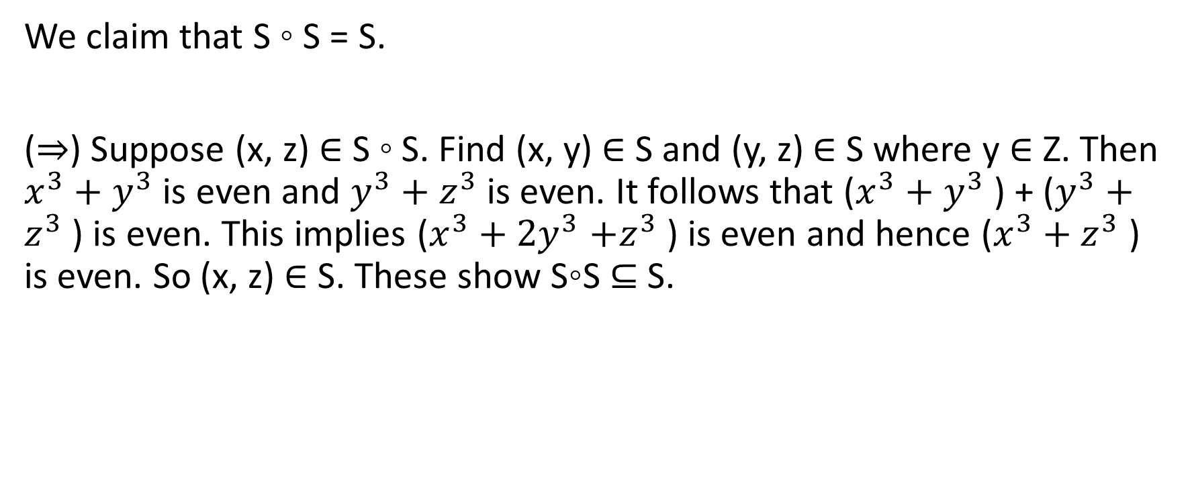
Sheet 4: Question 6
We claim that S ◦ S = S.
(⇒) Suppose (x, z) ∈ S ◦ S. Find (x, y) ∈ S and (y, z) ∈ S where y ∈ Z. Then $x^{3}+y^{3}$ is even and $y^{3}+z^{3}$ is even. It follows that ($x^{3}+y^{3}$ ) + ($y^{3}+z^{3}$ ) is even. This implies ($x^{3}+{2y}^{3}$ $+z^{3}$ ) is even and hence ($x^{3}+z^{3}$ ) is even. So (x, z) ∈ S. These show S◦S ⊆ S.

Slide 24
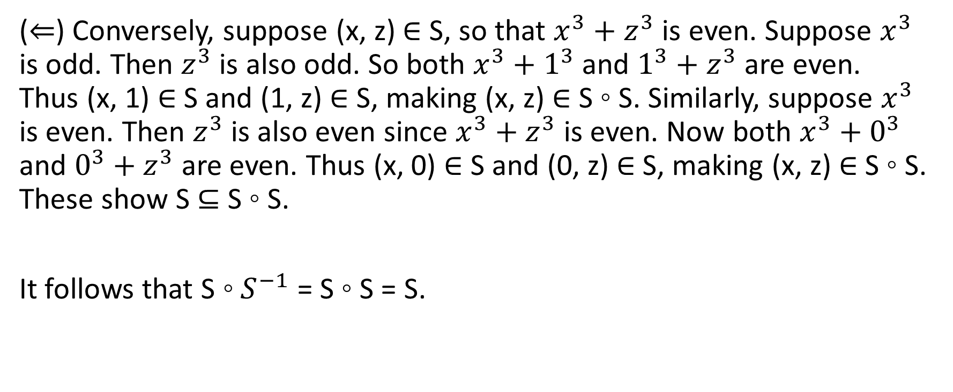
Sheet 4: Question 6
(⇐) Conversely, suppose (x, z) ∈ S, so that $x^{3}+z^{3}$ is even. Suppose $x^{3}$ is odd. Then $z^{3}$ is also odd. So both $x^{3}+1^{3}$ and $1^{3}+z^{3}$ are even. Thus (x, 1) ∈ S and (1, z) ∈ S, making (x, z) ∈ S ◦ S. Similarly, suppose $x^{3}$ is even. Then $z^{3}$ is also even since $x^{3}+z^{3}$ is even. Now both $x^{3}+0^{3}$ and $0^{3}+z^{3}$ are even. Thus (x, 0) ∈ S and (0, z) ∈ S, making (x, z) ∈ S ◦ S. These show S ⊆ S ◦ S.
It follows that S ◦ $S^{−1}$ = S ◦ S = S.

Slide 25
Sheet 4: Question 7
Starred question.

Slide 26
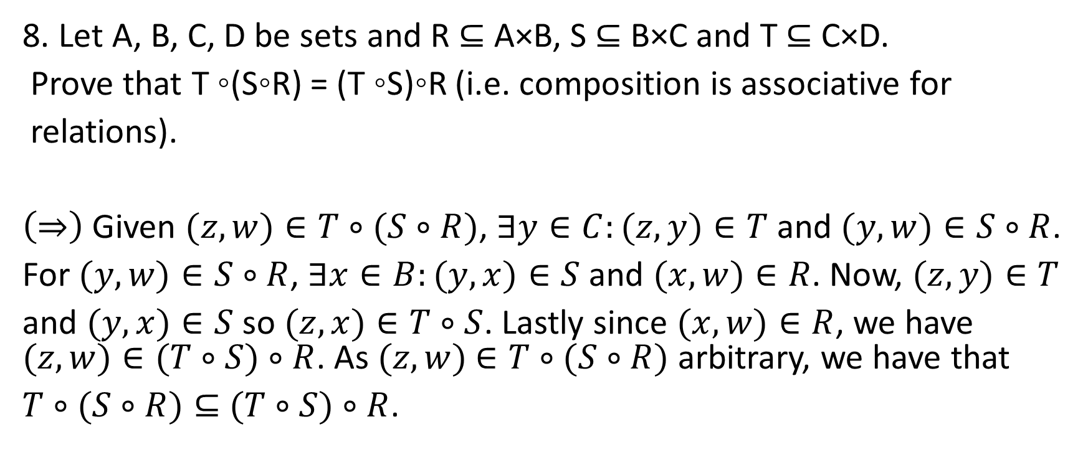
Sheet 4: Question 8
8. Let A, B, C, D be sets and R ⊆ A×B, S ⊆ B×C and T ⊆ C×D.
Prove that T ◦(S◦R) = (T ◦S)◦R (i.e. composition is associative for
relations).
$\left(⇒\right)$Given $(z,w)∈T∘(S∘R)$, $∃y∈C:(z,y)∈T$ and $(y,w)∈S∘R$.
For $(y,w)∈S∘R$, $∃x∈B:(y,x)∈S$ and $(x,w)∈R$. Now, $(z,y)∈T$
and $(y,x)∈S$ so $(z,x)∈T∘S$. Lastly since $(x,w)∈R$, we have $(z,w)∈(T∘S)∘R$. As $(z,w)$ $∈T∘(S∘R)$ arbitrary, we have that
$T∘(S∘R)⊆$ $(T∘S)∘R$.

Slide 27

Sheet 4: Question 8 (Participation)
($⟸$)

Slide 28
Review of lectures
What is an undirected graph?

Slide 29
Review of lectures
Definition 5.3.6. An undirected graph is an ordered pair (V, E) where V is a set and E is a set all of whose elements are of the form {x, y} with x, y ∈ V .
the vertices or the nodes are the elements of V ;
(2) the edges are the elements of E;
(3) an edge between x and y is the element {x, y} ∈ E;
(4) a loop is an edge between a vertex and itself.

Slide 30
Review of lectures
What is a directed graph?

Slide 31
Review of lectures
Definition 5.3.3. A directed graph is an ordered pair (V, D) where V is a set and D is a binary relation on V .
the vertices or the nodes are the elements of V ;
(2) the edges are the elements of D;
(3) an edge from x to y is the element (x, y) ∈ D;
(4) a loop is an edge from a vertex to itself.

Slide 32
Sheet 4: Questions 9,10,11,12
To familiarise yourself with concepts from graph theory.
Identifying vertices and edges of graphs.
Sketching graphs given vertices and edges.
Using graphs as a visual representation of relations.

Slide 33
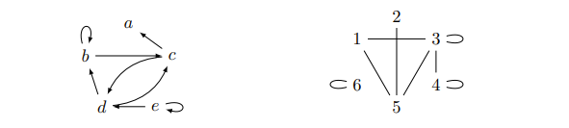
Sheet 4: Question 9
9. The directed graph (A, D) and the undirected graph (B, E) are shown below:
A = {a, b, c, d, e}, D = {(b, b),(b, c),(c, a),(c, d),(d, b),(d, c),(e, d),(e, e)}.
B = {1, 2, 3, 4, 5, 6}, E = {{3, 3}, {4, 4}, {6, 6}, {1, 3}, {1, 5}, {2, 5}, {3, 5}, {3, 4}}.

Slide 34
Sheet 4: Question 10
Starred question.

Slide 35
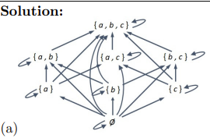
Sheet 4: Question 11
11. Draw the following directed graphs:
(P({a, b, c}), ⊆) where ⊆ is the “subset” relation;

Slide 36

Sheet 4: Question 11
(b) ({2, 3, 4, 5, 6, 12, 13, 14, 15, 16, 17, 18, 19, 20}, |), where | is the “divides” relation (from Tutorial 2, Problem 2).

Slide 37
Sheet 4: Question 12
Starred question.

Slide 38
Sheet 4: Question 13
An interesting puzzle.

Slide 39
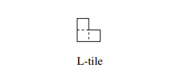

Sheet 4: Question 13
13. A C × C chessboard is a square divided into C rows of C unit squares, where C $∈ℤ^{+}$. For example, the usual chessboard is a $2^{3}×2^{3}$ chessboard. An L-tile is a $2^{1}{×2}^{1}$chessboard with one unit square missing (as shown).

Slide 40

Sheet 4: Question 13
Given a C × C chessboard and any one of its unit squares singled out (like the black one below), can the rest of the chessboard can be covered by non-overlapping L-tiles? (See the example below.)

Slide 41
Sheet 4: Question 13
Investigate into the cases C = 4, C = 5 and C = 6. (To be continued in Tutorial 5.)

Slide 42
Further problems: Equivalence relations
For a binary relation R on a set A, there are three important properties:
R is said to be reflexive if and only if “xRx for any x in A”.
R is symmetric if and only if “for every x and y in A, if xRy then yRx.”
R is transitive if and only if “for all x, y and z in A, if xRy and yRz, then xRz.”

Slide 43
Further problems: Equivalence relations
A relation R on set A is an equivalence relation if it is reflexive, symmetric and transitive.
We will consider a few relations and determine if they are equivalence relations.

Slide 44

Further problems: Equivalence relations
Consider the division relation on set $ℤ$. i.e for $k,n∈ℤ$ we say that $k|n$ if $k≠0$ and $∃m∈ℤ:n=km$.
Is the division relation reflexive?

Slide 45

Further problems: Equivalence relation
No. $0∤0$.

Slide 46

Further problems: Equivalence relation
Consider the division relation on set $ℤ$. i.e for $k,n∈ℤ$ we say that $k|n$ if $k≠0$ and $∃m∈ℤ:n=km$.
Is the division relation symmetric?

Slide 47

Further problems: Equivalence relation
No, $1|2$ but $2∤1$.

Slide 48

Further problems: Equivalence relation
Consider the division relation on set $ℤ$. i.e for $k,n∈ℤ$ we say that $k|n$ if $k≠0$ and $∃m∈ℤ:n=km$.
Is the division relation transitive?

Slide 49

Further problems: Equivalence relation
Yes. Suppose that a$|b$ and b$|c$. $a,b ≠0$ and $∃p,q∈ℤ$ where $b=pa$ and $c=qb$. So $c=qpa$. Hence $a|c$.

Slide 50

Further problems: Equivalence relation
Consider the set $ℤ^{+}$. For positive integers $m,n$ we say that $mRn$ iff $∃a,b∈$ $ℤ^{+}$ such that $m^{a}=n^{b}$. Is R an equivalence relation?

Slide 51
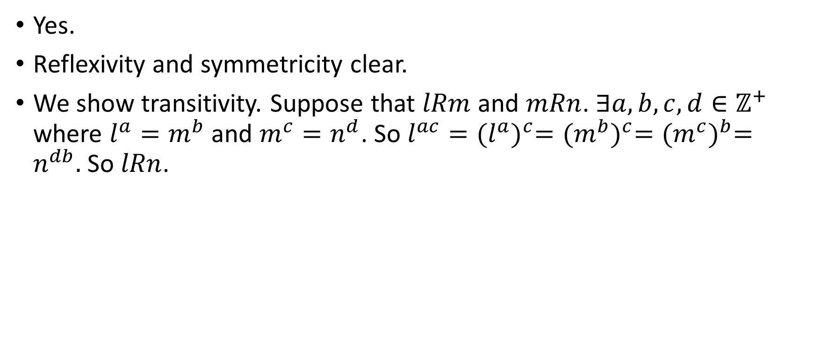
Further problems: Equivalence relation
Yes.
Reflexivity and symmetricity clear.
We show transitivity. Suppose that $lRm$ and $mRn$. $∃a,b,c,d∈ℤ^{+}$ where $l^{a}=m^{b}$ and $m^{c}=n^{d}$. So $l^{ac}={(l^{a})}^{c}={(m^{b})}^{c}={(m^{c})}^{b}=n^{db}.$ So $lRn$.

Slide 52
Questions

